Slide 1

Quiz 2 : game analytics
BADS7205 Data Streaming and Real Time Anaytics
Team SKY
นาย กชกร เลื่อนสุขสันต์ รหัส 6310412001
นาย สลิลวสุ เที่ยงธรรม รหัส 6310412017
นางสาว สุพัตรา ต้งัสกุลระหง รหัส 6310412028

Slide 2




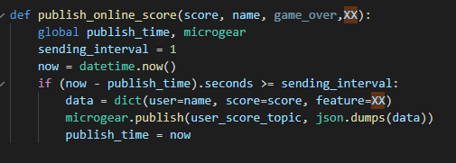

publish_online_score
{ ‘user’ : ‘Waew’,
‘score’ : 54,
‘feature’: [431.2692307692308,241.0,31,23,28,5,4,94,72,43,51] }

Slide 3
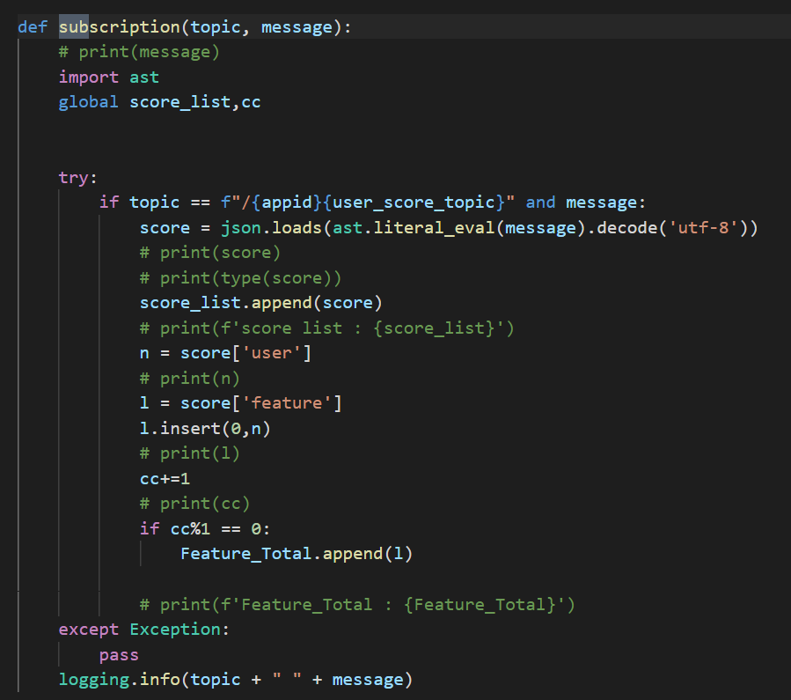
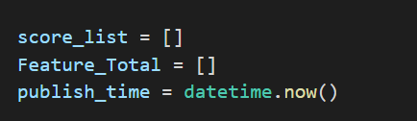
Subscription
{ ‘user’ : ‘Waew’,
‘score’ : 54,
‘feature’: [431.2692307692308,241
,31,23,28,5,4,94,72,43,51] }
Feature_Total
[['Waew', 365.27777777777777, 230.30555555555554, 8, 9, 9, 0, 2, 26, 18, 19, 18], ['Waew', 368.0, 500, 0, 0, 0, 0, 1, 1, 0, 5, 5],
['Waew', 345.25, 484.25, 0, 0, 0, 0, 1, 2, 1, 5, 5],
['Moss', 368.0, 500, 0, 0, 1, 1, 1, 1, 0, 5, 5],
['Waew', 368.0, 409.0, 0, 0, 0, 0, 1, 3, 1, 5, 5],
['Moss', 345.25, 500, 0, 0, 2, 2, 1, 2, 0, 5, 5],
['Waew', 347.875, 371.375, 0, 1, 1, 0, 1, 4, 1, 6, 5],
['Moss', 326.0, 500, 0, 0, 3, 3, 1, 4, 0, 5, 5],
['Waew', 384.8, 348.8, 0, 2, 2, 0, 1, 5, 2, 6, 5],
['Moss', 321.625, 500, 0, 0, 3, 3, 1, 4, 0, 5, 5],
['Waew', 403.0, 304.0, 2, 2, 2, 0, 1, 6, 4, 7, 7]]

Slide 4
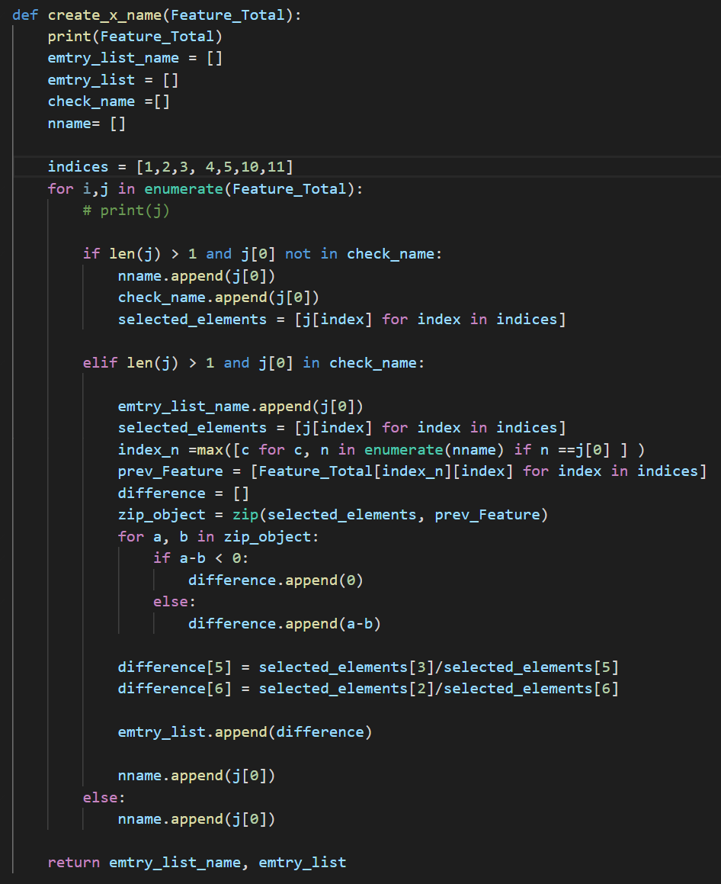
Select Feature
● A0) Position in X axis => position X [1, 2, 3, 2, 1] / 5
● A1) Position in Y axis => position Y [200, 150, 130, 170] / 4
● A2) Number of coins collected => Total
● A3) Number of destroyed enemies => Total
● A4) Number of shots => Total
● A9) Number of enemy created => Total
● A10) Number of coin created => Total
โดยใช้ค่าแตกต่างระหว่าง 1 วินาที
วินาทีแรก
Waew,430.1796875,242.421875,30,23,28,5,4,92,71,43,50
วินาทีถัดมา
Waew,431.2692307692308,241.0, 31,23,28,5,4,94,72,43,51
1.09, 0, 1, 0, 0 ,0.53, 0.6078

Slide 5
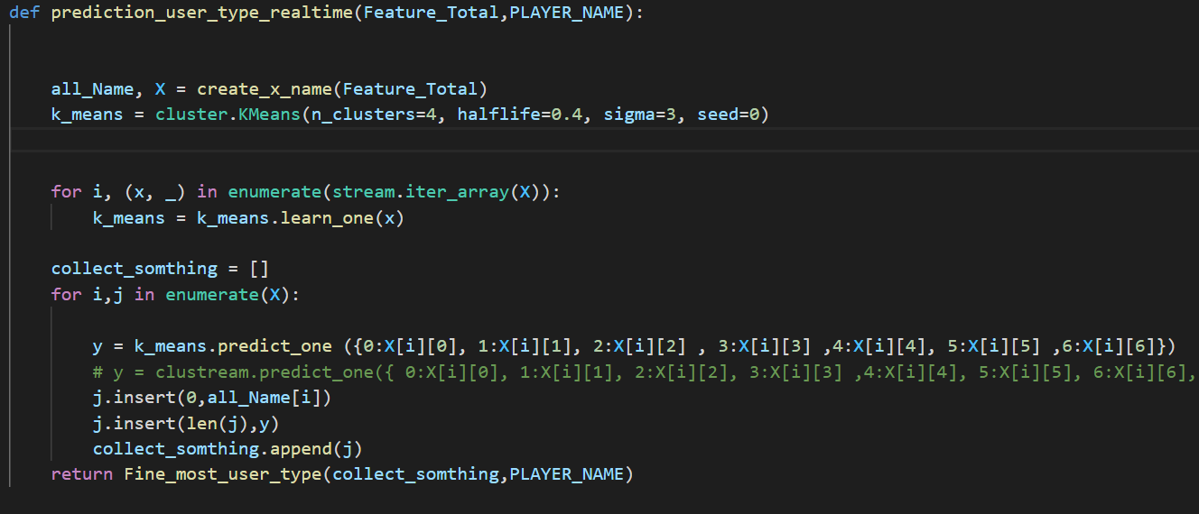
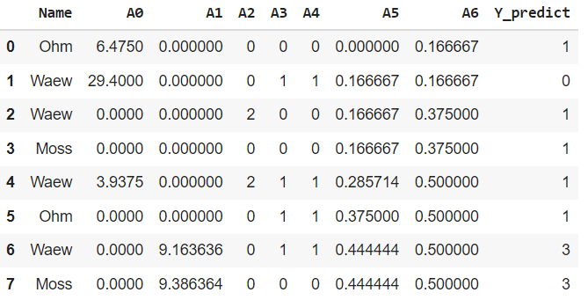
Predict_user_type_realtime (1)
Use K-mean for 4 group Clustering
List Collect_somthing

Slide 6
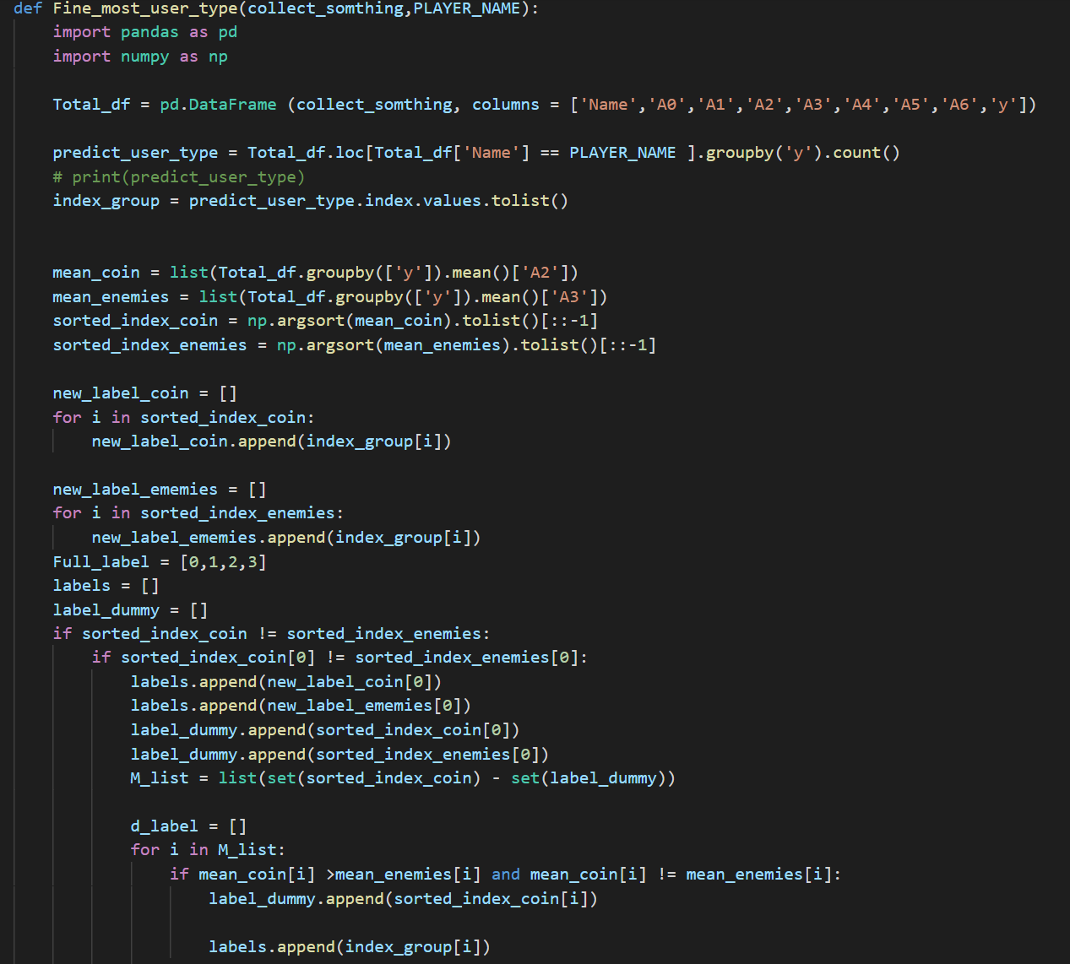
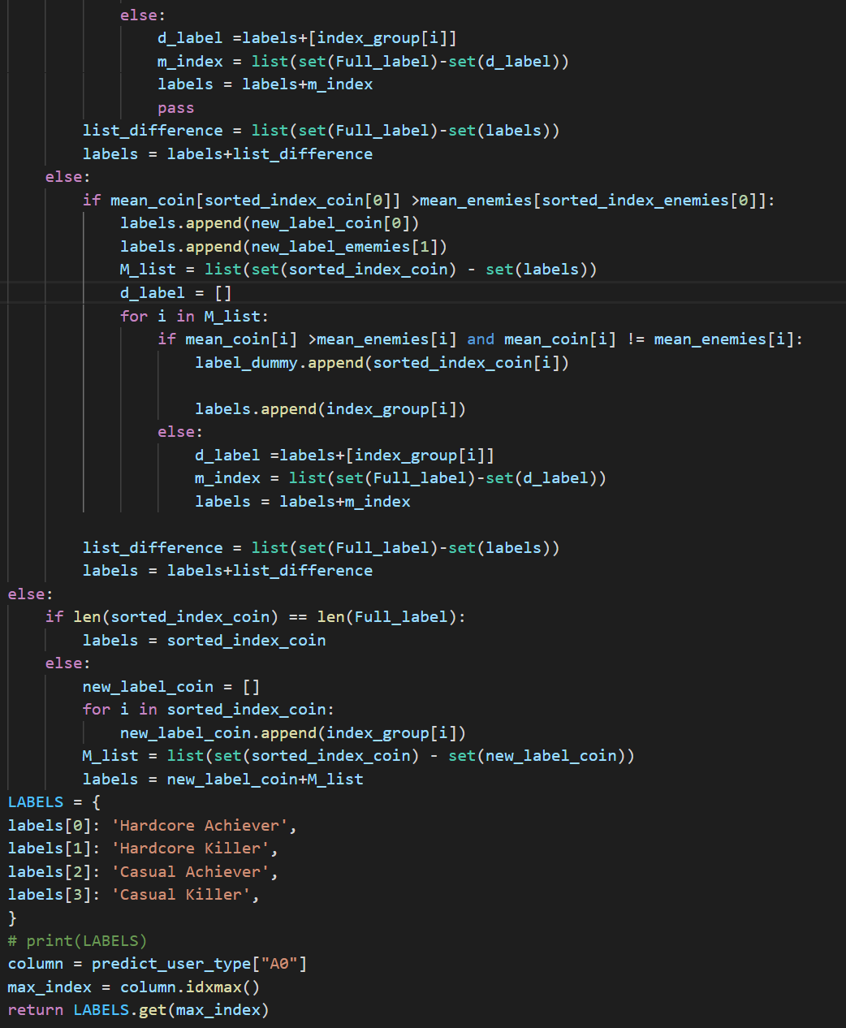

Predict_user_type_realtime (2)
Find Most User Type
Rank by mean A2 and A3
{2: 'Hardcore Achiever’,
3: 'Hardcore Killer’,
1: 'Casual Achiever’,
0: 'Casual Killer'}
User Type
'Hardcore Achiever’

Slide 7
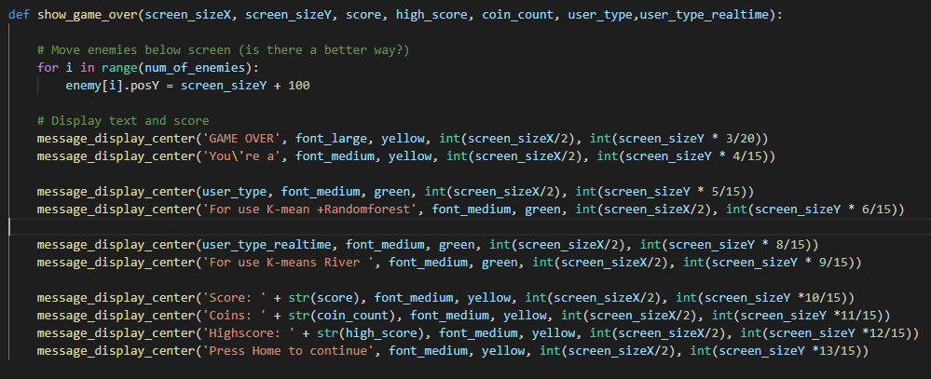
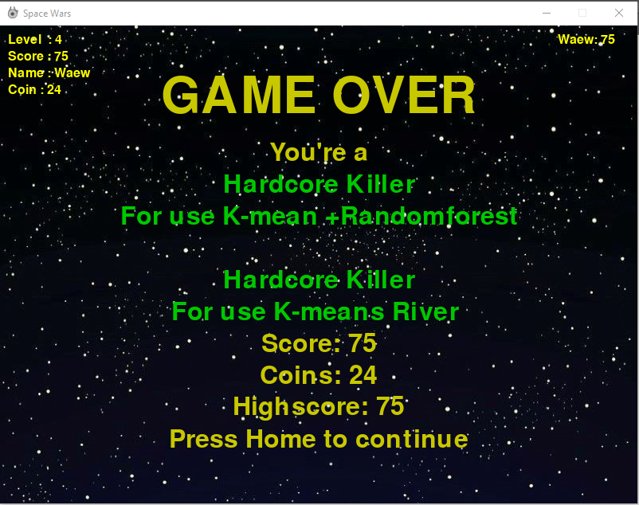
Game_Over

